Slide 1




#techninebe
Technine Group
Erik Moreau
emo@aurelium.be
@ErikMoreau
Technine Group

Slide 2
A quick Show of Hands
Who’s running XP
Who’s running Vista
Who’s running 7
Who’s running 8
Who’s already running 8.1
Notes:
Question the audience which version of the client OS they are running

Slide 3


Start Button
The Start Button is Back!
=>
The renewed start is no longer auto pinning all your apps/programs
Search Everywhere with Bing integration

Slide 4
Modern UI Tweaks
Now you can:
  boot/return to the desktop
  use your desktop background as start background
  get start to open on your active screen
  show all apps view on start (like your old startmenu)
  show your programs before the apps in start
Apps are updated Automatically in the background

Slide 5
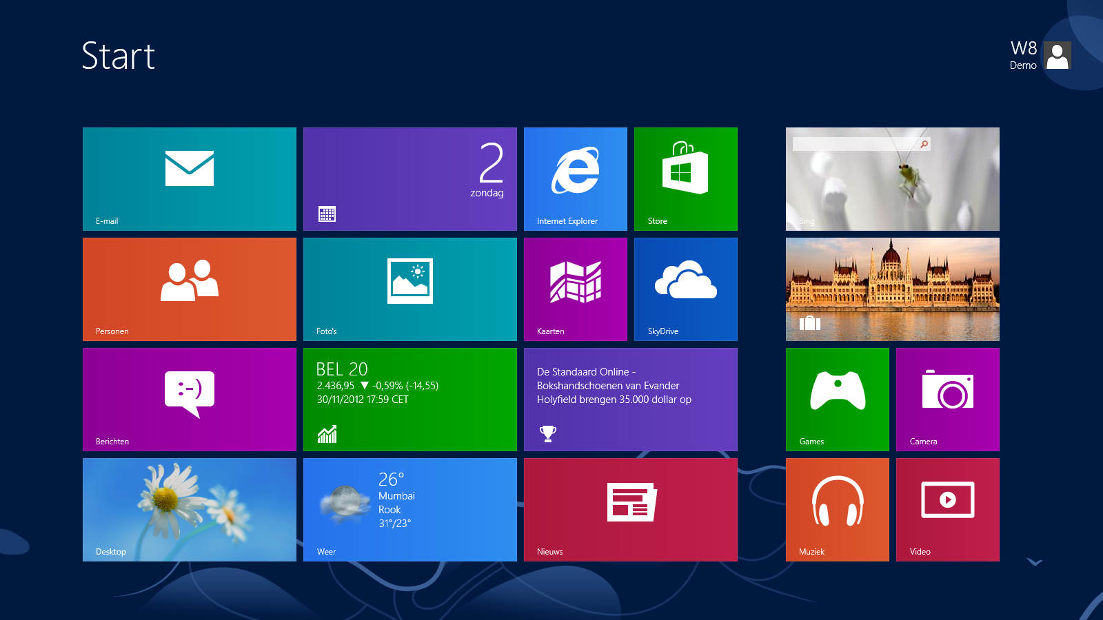
THE Windows 8 Startscreen
Notes:
The New StartScreen puts you most needed apps on the screen without the need to go to start
In the past everyone moved icons to the desktop or the taskbar to have easy access, now the are here for you!

Slide 6
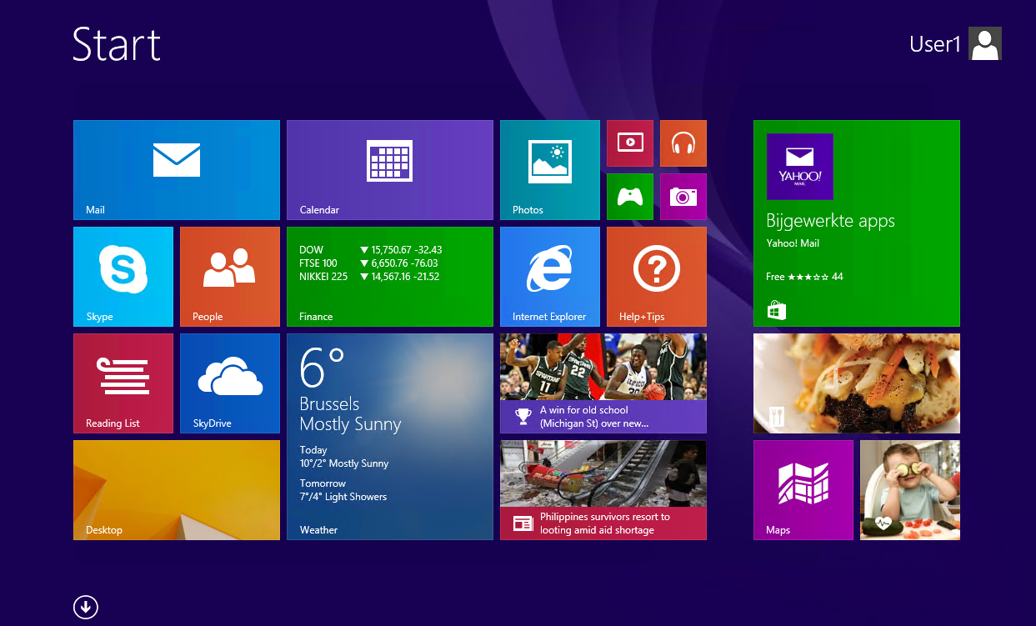
THE Updated Windows 8.1 Startscreen
Notes:
The New StartScreen puts you most needed apps on the screen without the need to go to start
In the past everyone moved icons to the desktop or the taskbar to have easy access, now the are here for you!

Slide 7
VErsions
RT/8.1/PRO/ENT
Common new Features:
  Intergated VPN
  Workplace join Work Folders
  Broadband Hotspot
  Device Enrollment / Remote Business data removal
RT: Office Home & Student now also has Outlook
http://www.microsoft.com/en-us/windows/enterprise/products-and-technologies/windows-8-1/compare/default.aspx

Slide 8
The Requirements
Processor: 1 gigahertz (GHz) or faster with support for PAE, NX, and SSE2
RAM: 1 gigabyte (GB) (32-bit) or 2 GB (64-bit)
Hard disk space: 16 GB (32-bit) or 20 GB (64-bit)
Graphics card: Microsoft DirectX 9 graphics device with WDDM driver
http://windows.microsoft.com/en-US/windows-8/system-requirements
Same as Win 8 except for:
  To install a 64-bit OS on a 64-bit PC, your processor needs to support CMPXCHG16b, PrefetchW, and LAHF/SAHF
Notes:
The need for PAE excludes older Centrino processors from the game
PrefetchW is missing on Intern Core 2 Duo processors / some older AMD processors also no longer support x64

Slide 9
More details
Windows Media Center license sold separately
http://windows.microsoft.com/en-US/windows-8/feature-packs
http://windows.microsoft.com/en-us/windows-8/update-from-windows-8-tutorial
Notes:
Store APPS 1024x768
APP Snapping 1366x768
Mesia Center License is temporary free

Slide 10
Demo Time
Help + Tips App
1st Sign in Tips
Updated Admin Tools
Organize & Sync Start Screen / App List
Multiple App Docking / smarter multi-app behaviour
Shutdown or Turn off?
…..
Notes:
Demo Time!

Slide 11
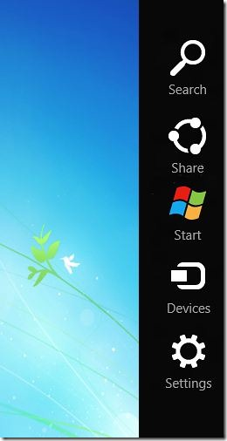
Keyboard Shortcut Keys
Win+C – Charms Bar
Win+F – Search Files
Win+W – Search Settings
Win+D - Desktop
Win+E - Explorer
Win+R - Run
Win+Plus or Win+Minus - Magnifier/Zoom In and Out
Win+Print Screen – Print Screen to the Pictures Folder
Alt+Tab - Switch between Apps
Win+Tab - Switch between Full Screen Apps
Win+I – Settings in the Charms Bar
Win+X – Admin Tools
Win+S – Search Everywhere (mind OneNote)

Slide 12
Questions?

